Slide 1
Introduction to Docker
Emp id-6162

Slide 2
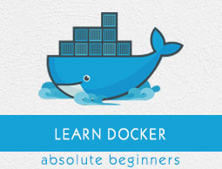
What is Docker?

Slide 3
Features
Docker has the ability to reduce the size of development by providing a smaller footprint of the operating system via containers.
With containers, it becomes easier for teams across different units, such as development, QA and Operations to work seamlessly across applications.

Slide 4
Docker - Hub
Docker Hub is a registry service on the cloud that allows you to download Docker images that are built by other communities.

Slide 5
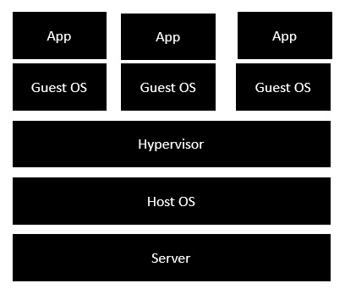
Architecture
Cloud

Slide 6
Cloud
Nodes
Cloud Repository
Continuous Integration
Application Deployment
Continuous Deployment

Slide 7
Thank You

